Slide 1
Lesson objective
Title: Operations with fractions
Aim – be able to:
Use written strategies to perform the 4 operations with fractions
Plan:
Review multiplication and division
Applications

Slide 2
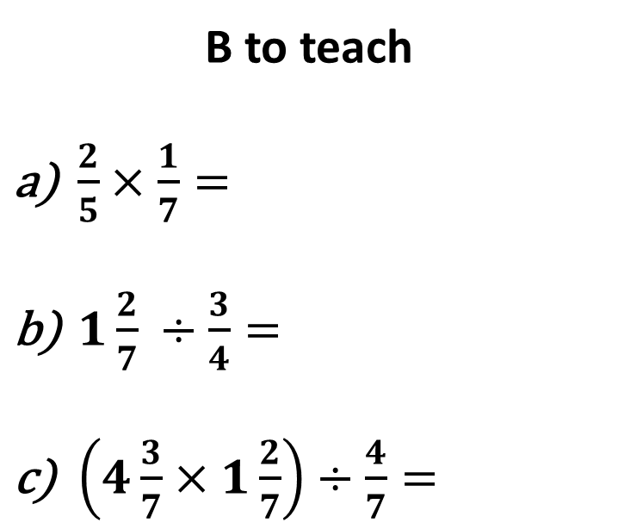
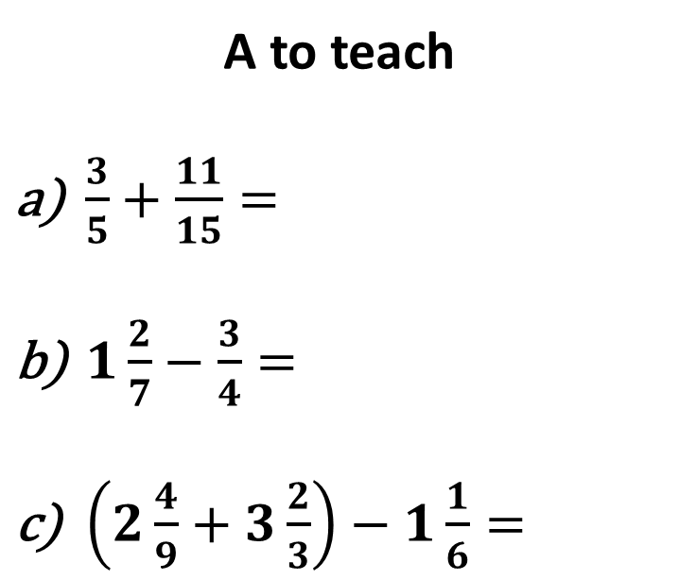
Review
In pairs, select a person to be A, the other is B. One of you will teach, the other will learn.
A to teach
$\frac{3}{5}+\frac{11}{15}=$
$1\frac{2}{7}−\frac{3}{4}=$
$\left(2\frac{4}{9}+3\frac{2}{3}\right)−1\frac{1}{6}=$
B to teach
$\frac{2}{5}×\frac{1}{7}=$
$1\frac{2}{7} ÷\frac{3}{4}=$
$\left(4\frac{3}{7}×1\frac{2}{7}\right)÷\frac{4}{7}=$

Slide 3
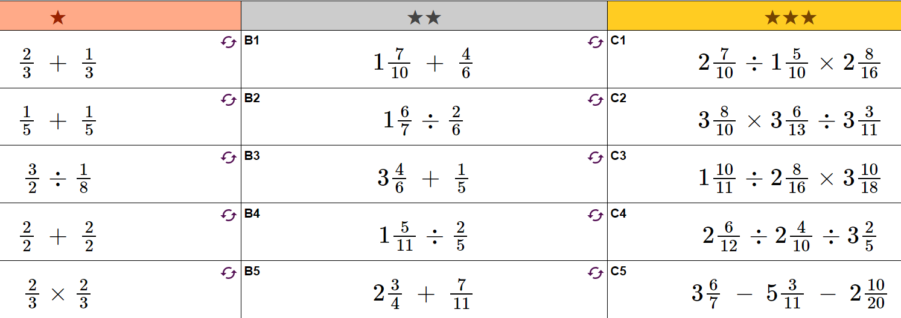

Slide 4
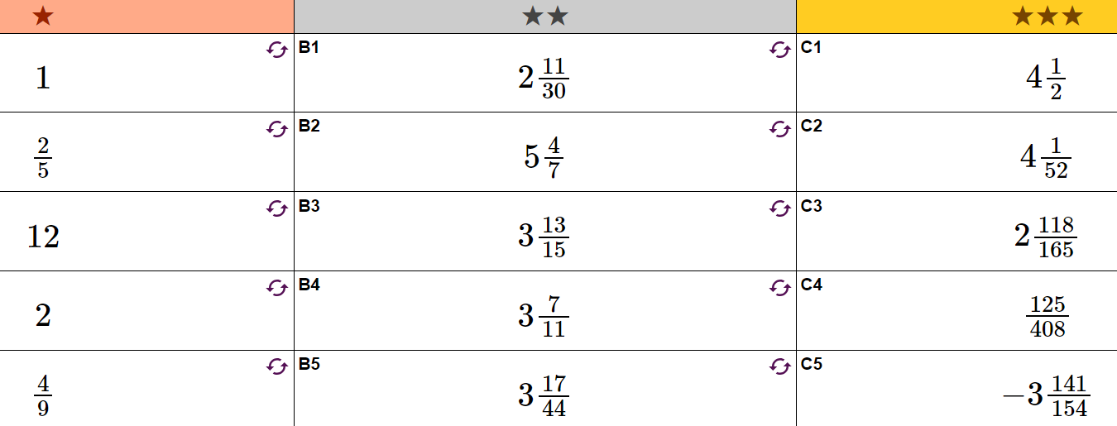

Slide 5
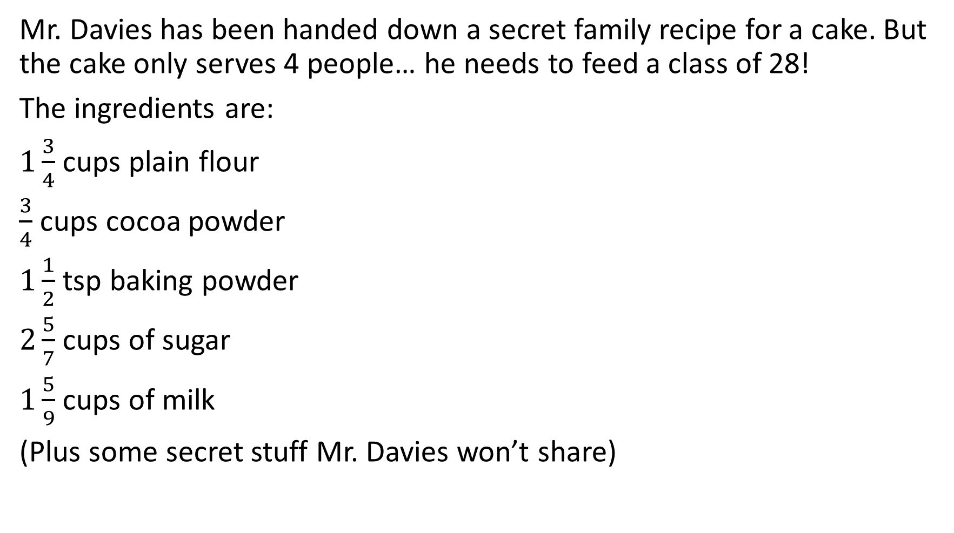
Mr. Davies Secret recipe – exercise book!
Mr. Davies has been handed down a secret family recipe for a cake. But the cake only serves 4 people… he needs to feed a class of 28!
The ingredients are:
$1\frac{3}{4}$ cups plain flour
$\frac{3}{4}$ cups cocoa powder
$1\frac{1}{2}$ tsp baking powder
$2\frac{5}{7}$ cups of sugar
$1\frac{5}{9}$ cups of milk
(Plus some secret stuff Mr. Davies won’t share)
How much of each ingredient does Mr. Davies actually need to feed the whole class?
How much would he need if he wanted to make a small 1 person cake?

